Slide 1



DATA WAREHOUSE DESIGN AND ETL IMPLEMENTATION: LOAN APPROVAL DATASET
Presented by
Deekshita Ganapathineedi

Slide 2



Dataset:Loan Approval
Loan issuance and approval trends.
Borrower demographics and business types.
Loan performance ( repayments, disbursement amounts ,etc).
Impact of loans on job creation and retention.
Differences in urban versus rural loan allocations.
01

Slide 3

Dimensions and Facts
Dimension Tables:
dim_borrower_data
dim_bank_data
dim_loandetails_data
dim_geography_data
Fact Table:
Loan_Fact
02

Slide 4
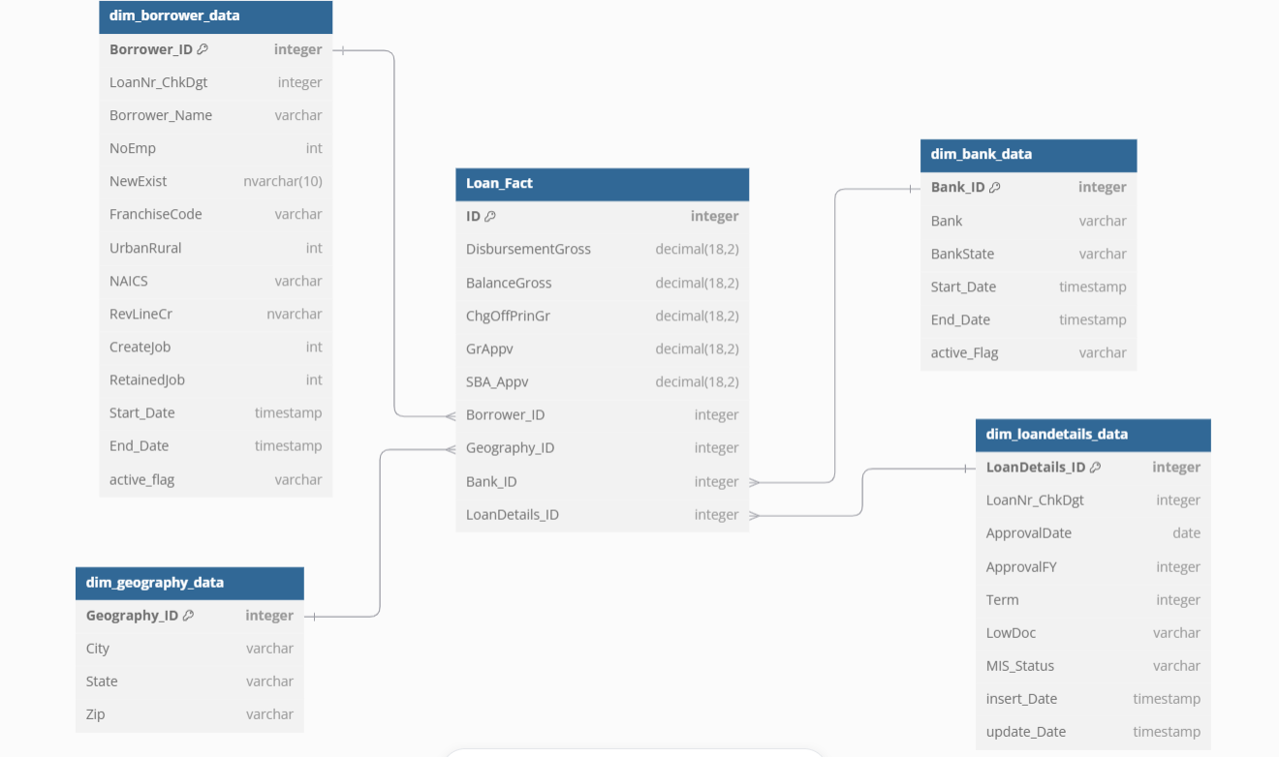
ER Diagram
03

Slide 5

LOAD TYPES
DIMENSION TABES:
Dim_borrower_data -->SCD2
Dim_bank_data ----> SCD2
Dim_loandetails_data -->SCD1
Dim_geography_data -->Regular mapping
FACT TABLE:
Loan_Fact --> SCD1
04

Slide 6
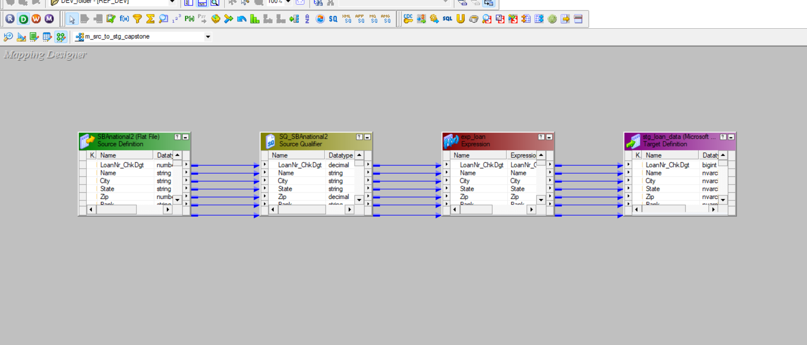

Mapping: m_src_to_stg_capstone
SOURCE TO STAGING
05

Slide 7
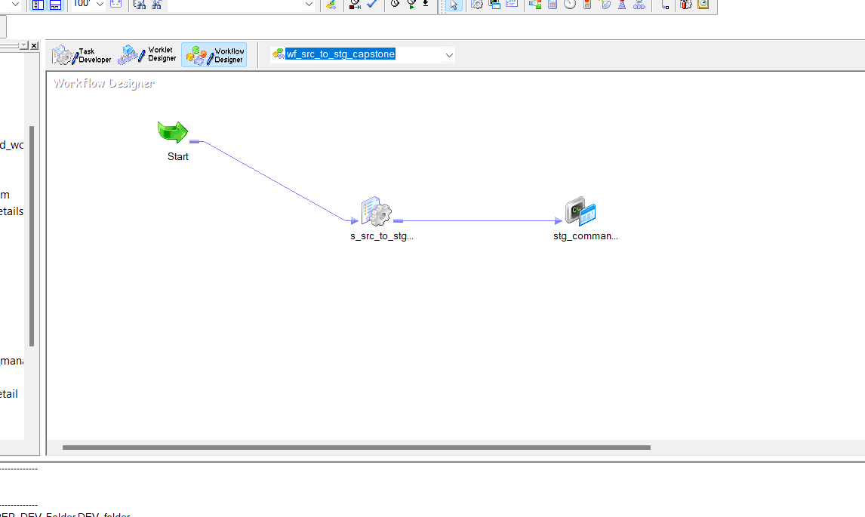
Workflow: wf_src_to_stg_capstone
06

Slide 8
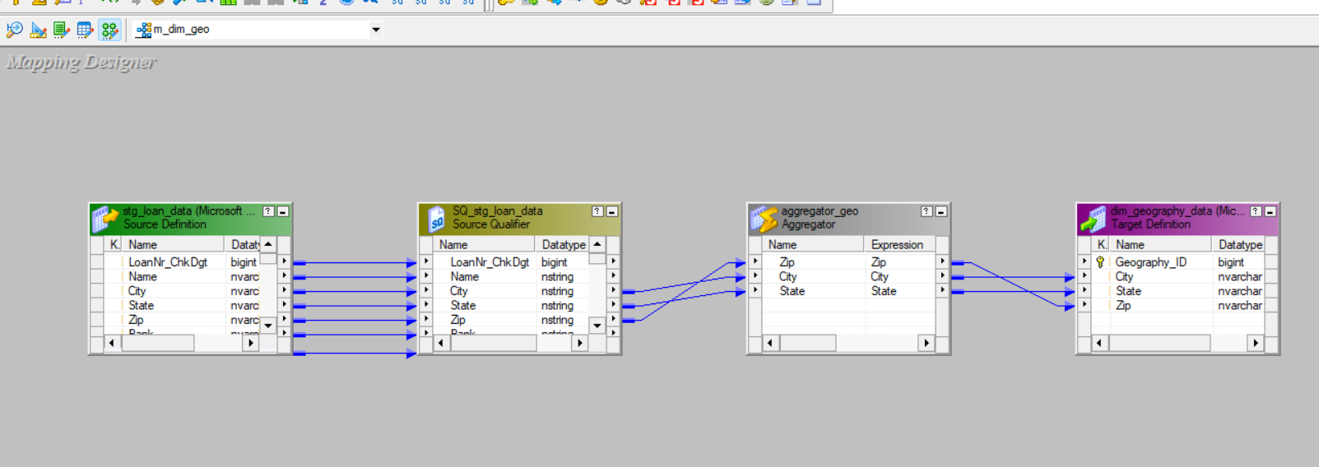
Mapping: m_dim_geo
Dim_geography_data
07

Slide 9
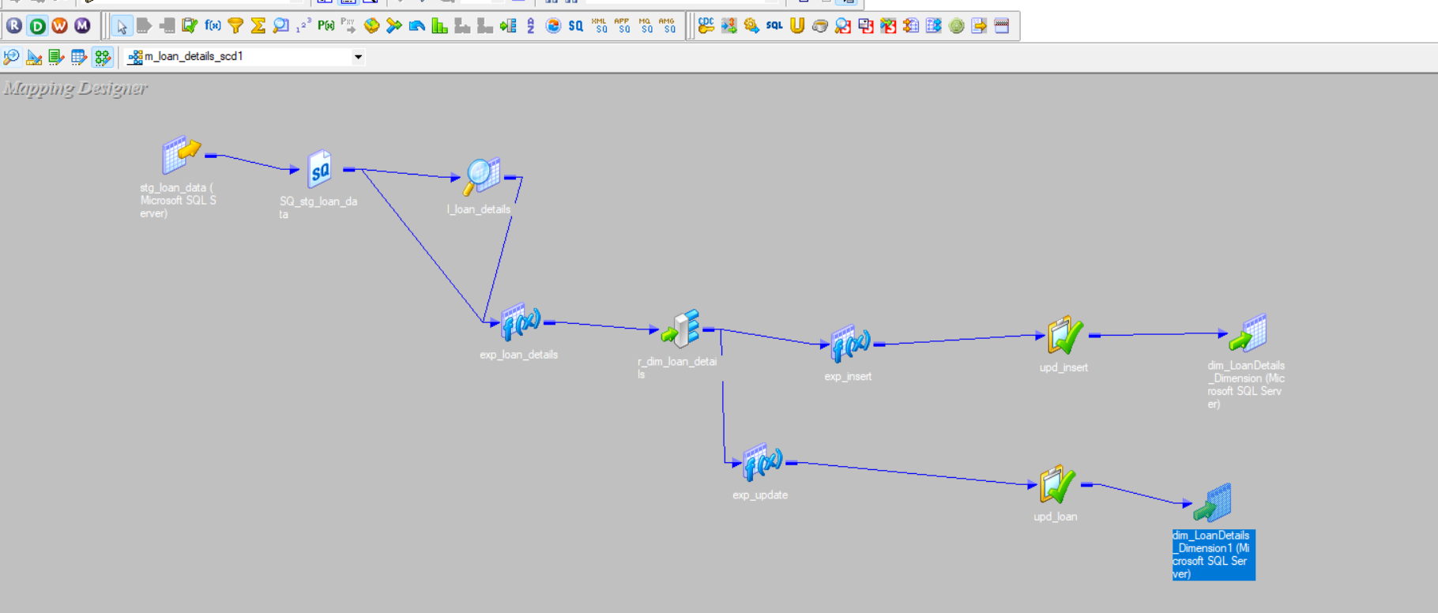
Mapping: m_loan_details_scd1
dim_loandetails_data
08

Slide 10
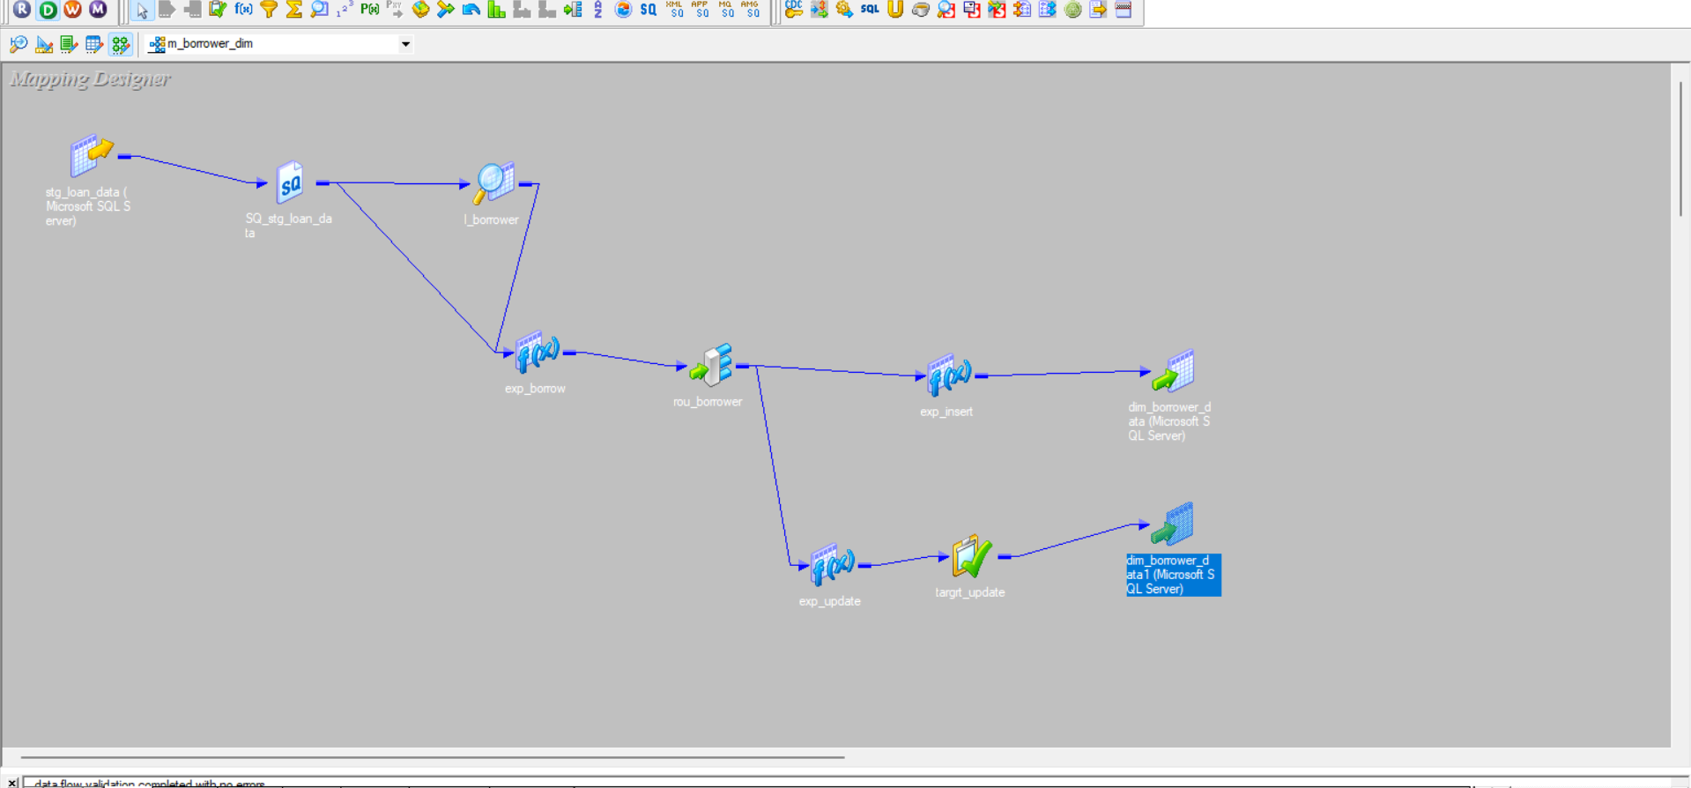
Mapping: m_borrower_dim
Dim_borrower_data
09

Slide 11
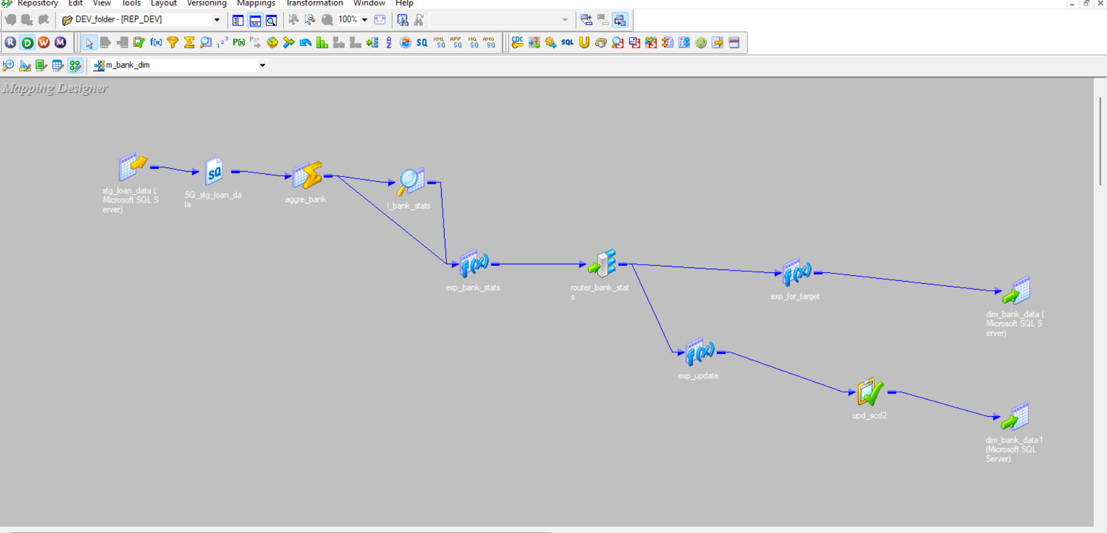

Mapping: m_bank_dim
Dim_bank_data
10

Slide 12
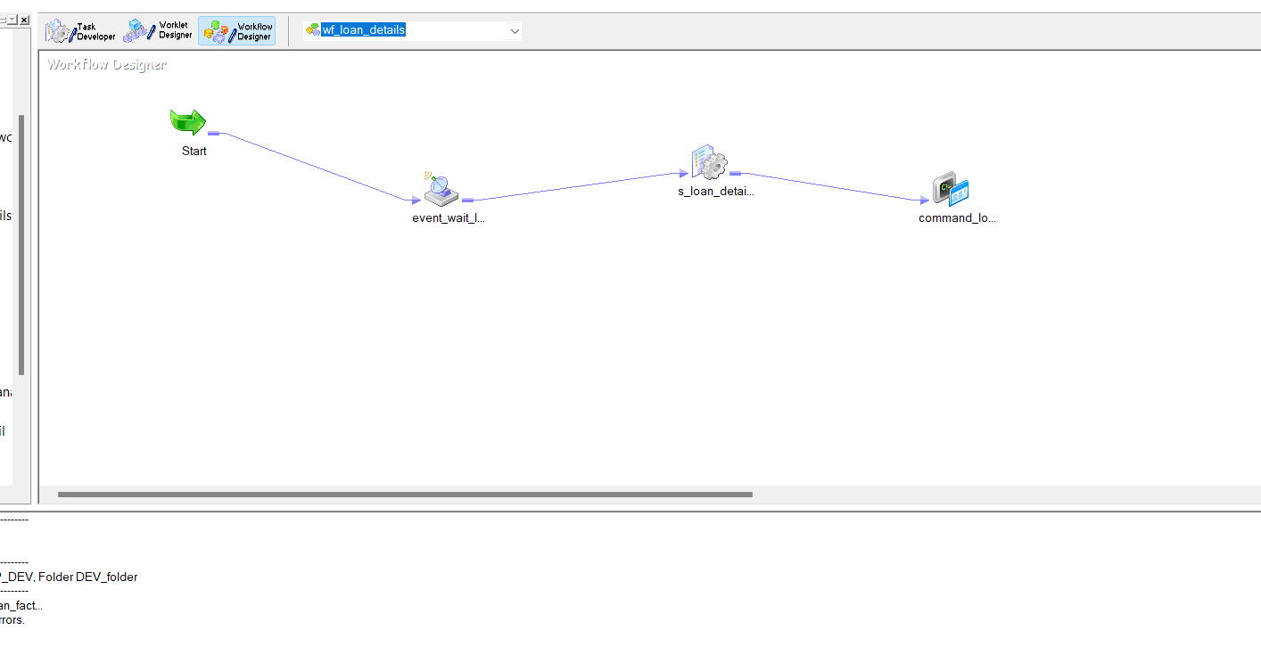

Workflow: wf_loan_details
dim_loandetails_data
11

Slide 13
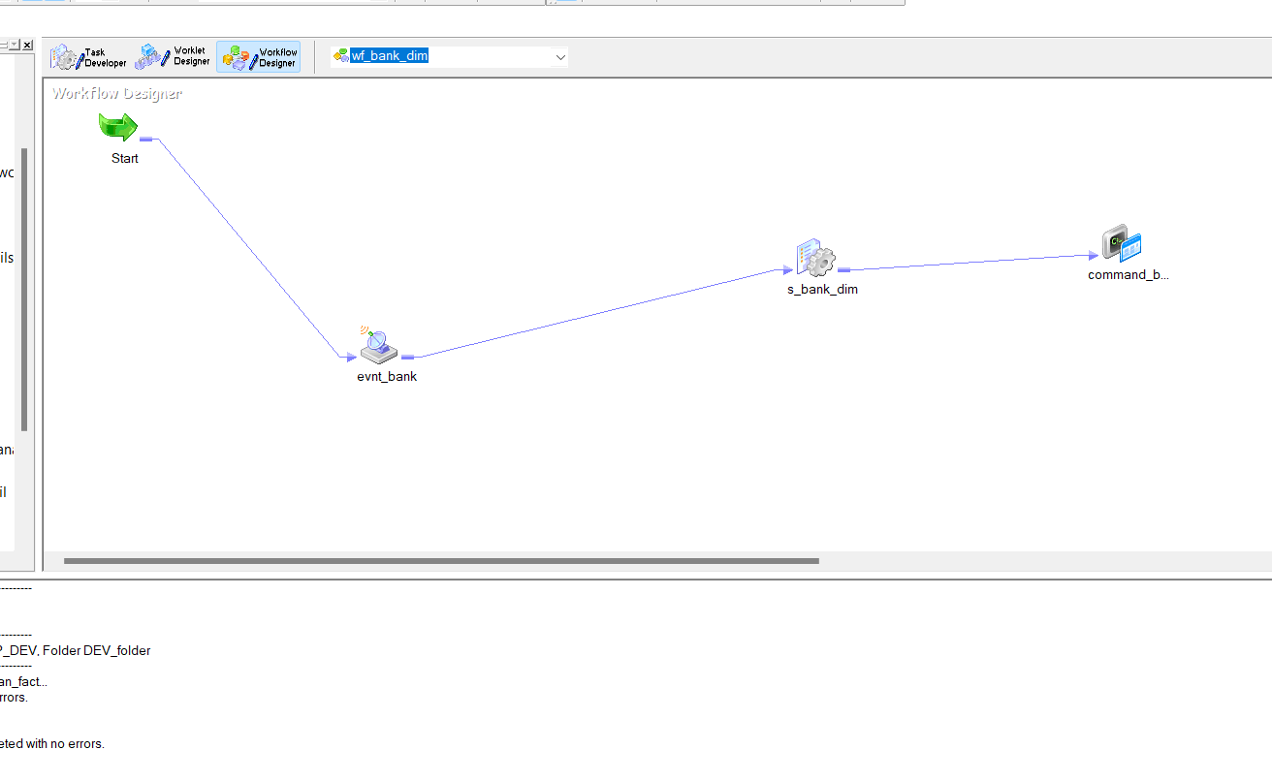
Workflow: wf_bank_dim
Dim_bank_data
12

Slide 14
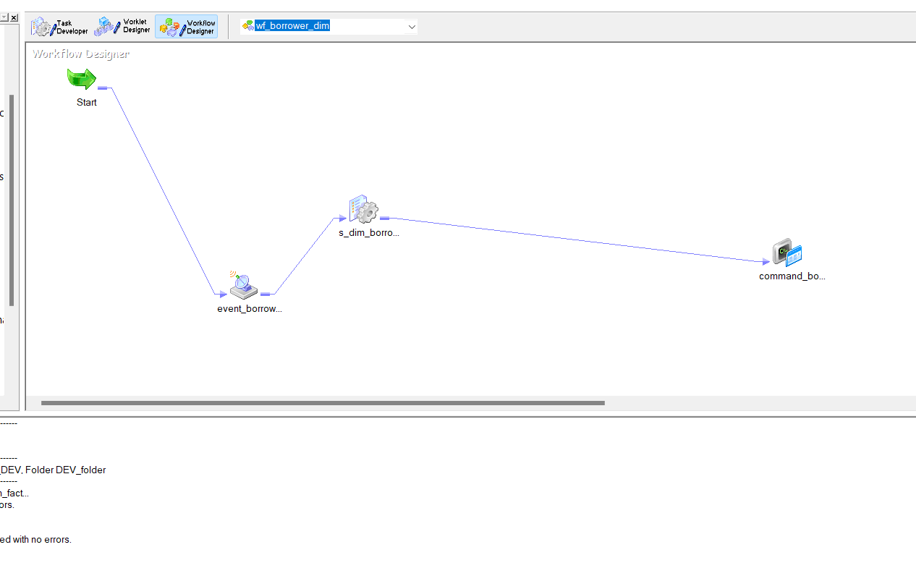
Workflow:wf_borrower_dim
Dim_borrower_data
13

Slide 15
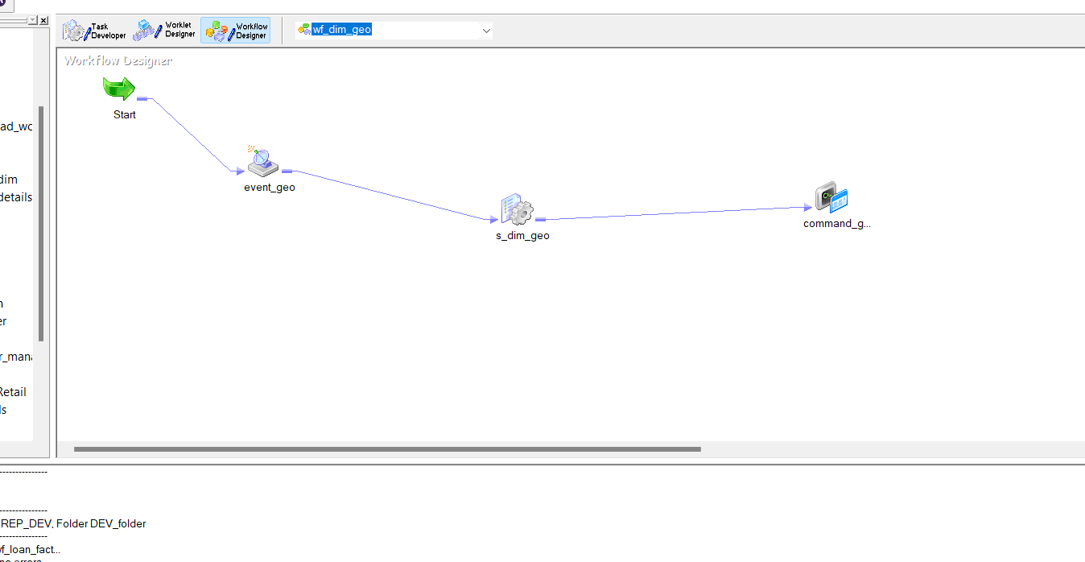
Workflow: wf_dim_geo
Dim_geography_data
14

Slide 16
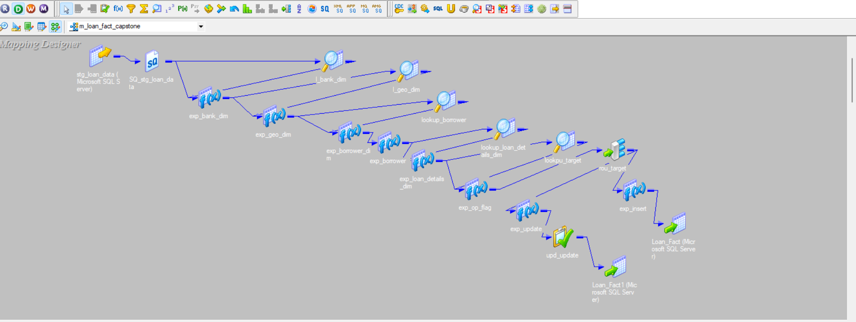
Mapping:m_loan_fact_capstone
Loan_Fact
15

Slide 17
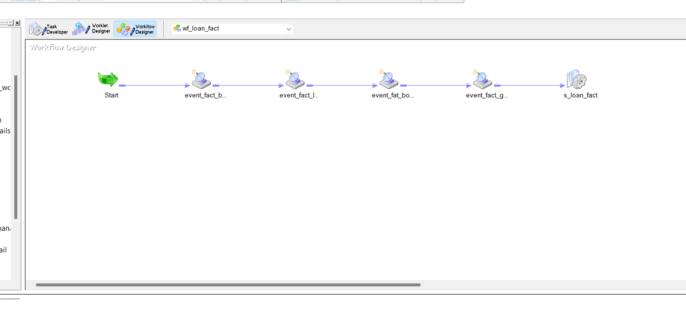
Workflow: wf_loan_fact
Loan_Fact
16

Slide 18
ANALYSIS
FROM PYTHON FLASK AND SQL
17

Slide 19
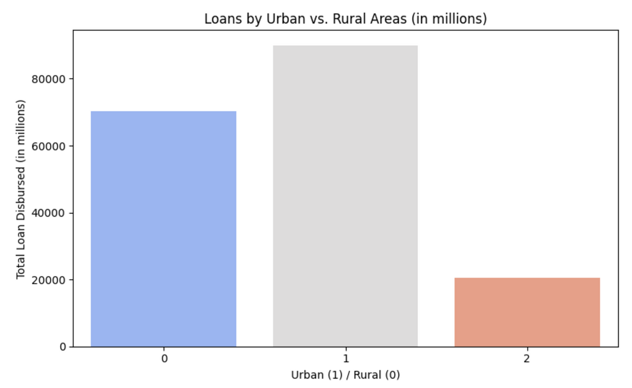
Urban vs Rural
18

Slide 20

Loan based on area
URBAN AREA | RURAL AREA | SUBURBAN AREA
There are 470,654 loans from urban areas, totaling $90,022,943,427.This information is useful for understanding the urban lending market and its economic impact. | There are 323,167 loans from rural areas, totaling $70,260,291,517 . This data is essential for understanding the lending landscape and its influence on rural economic development. | There are 105,343 loans from suburban areas, totaling $20,587,215,356 . Understanding suburban lending patterns provides insights into the unique needs and opportunities in suburban markets.
19

Slide 21
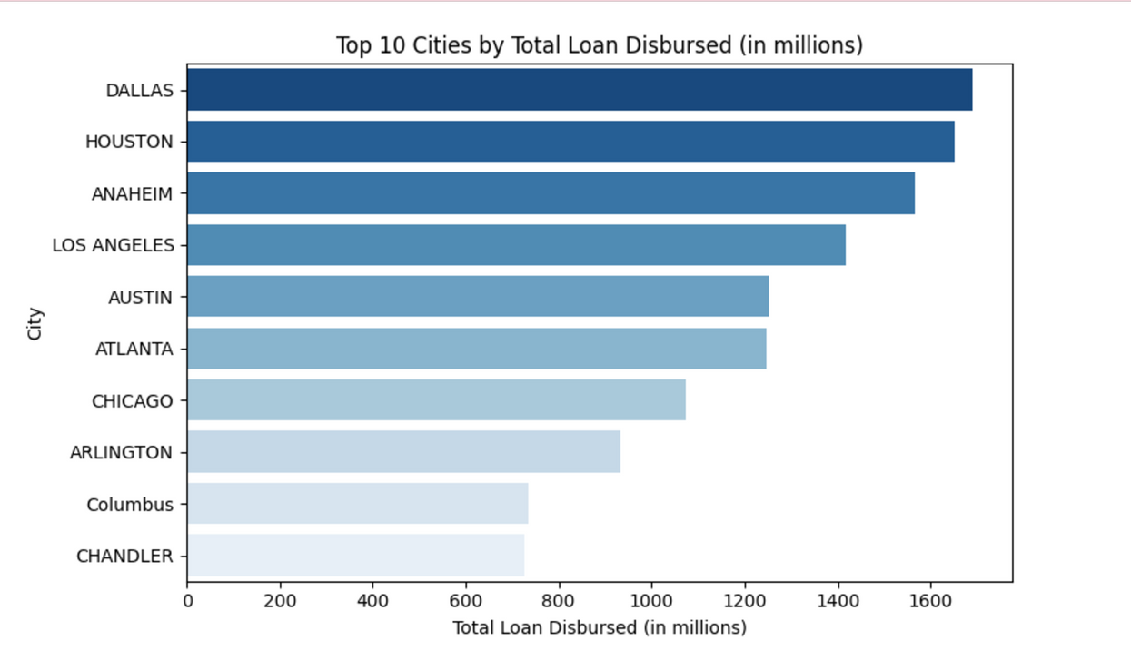
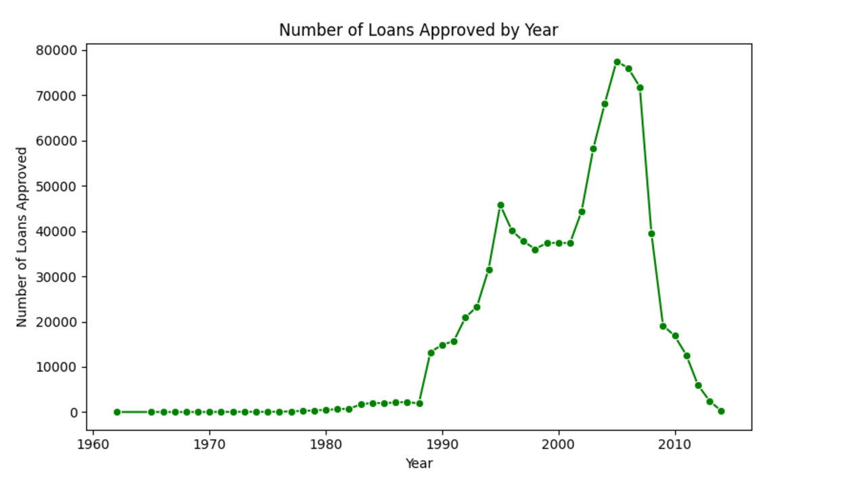
20

Slide 22

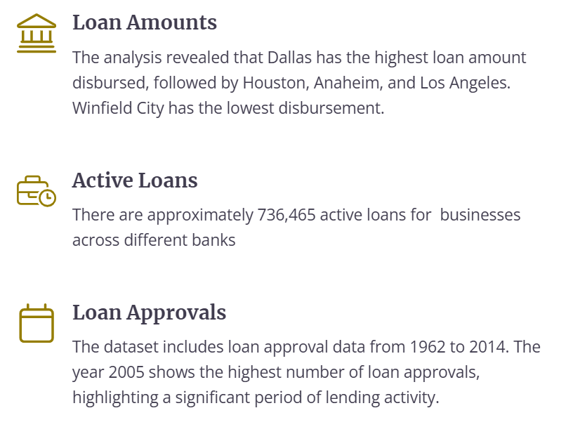
Deriving Insights
21

Slide 23
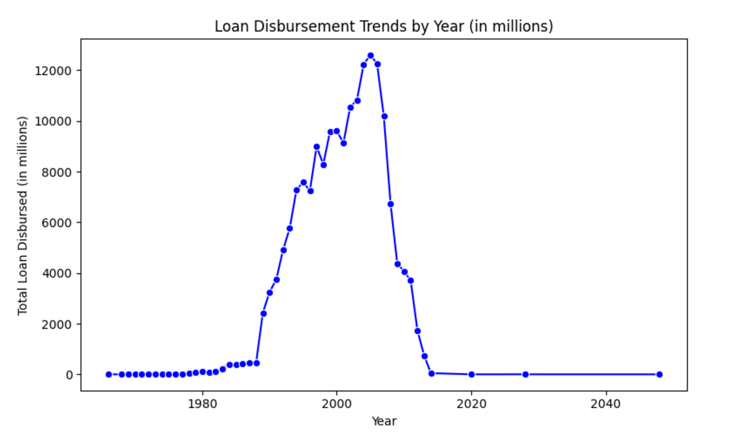
22

Slide 24
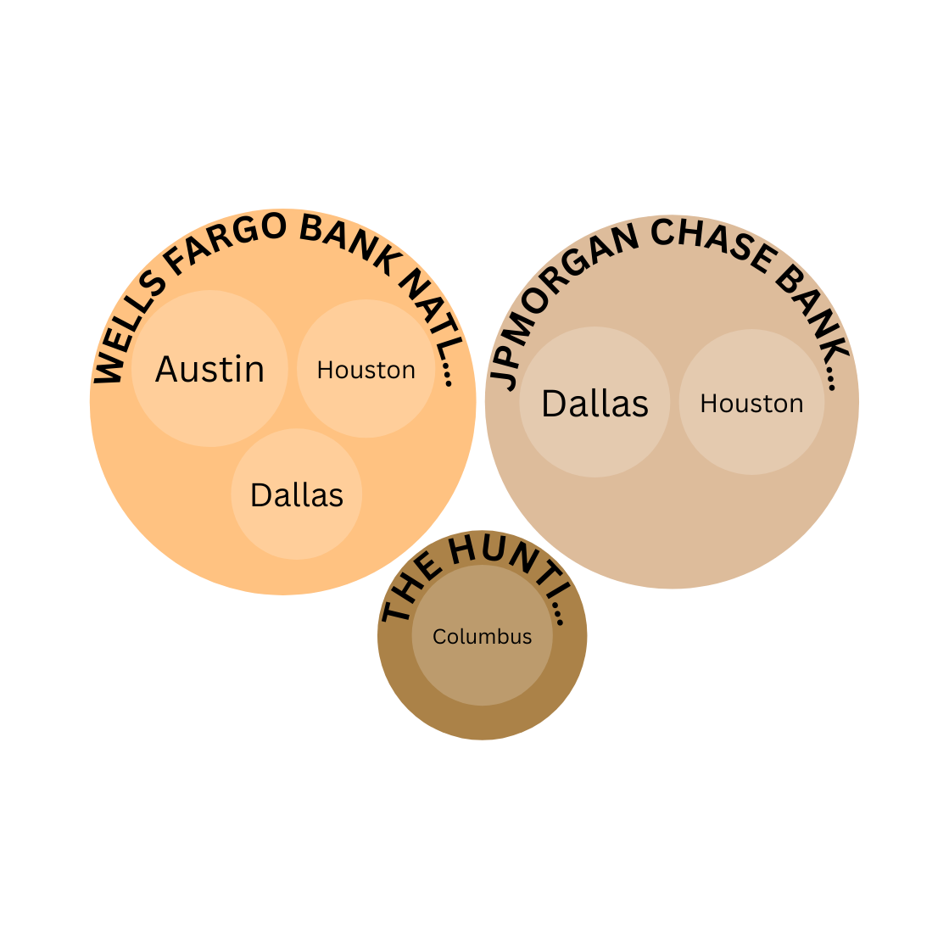

Data Analysis
23

Slide 25

Top Borrowers
1)DAYS INN
2)HOLIDAY INN EXPRESS
3)COMFORT INN
4)SUPER 8 MOTEL
5)SUBWAY
24

Slide 26
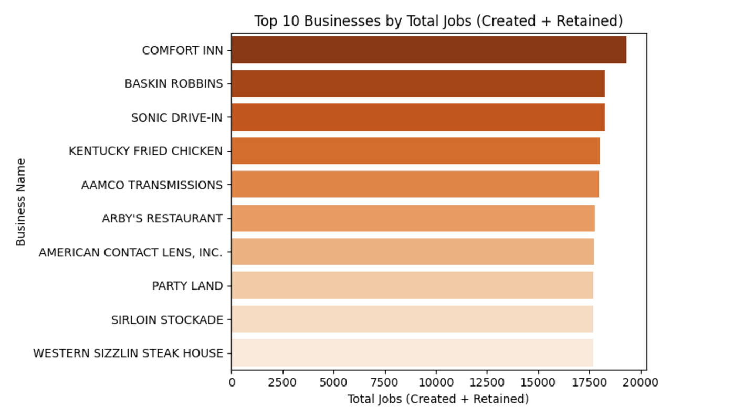
25

Slide 27
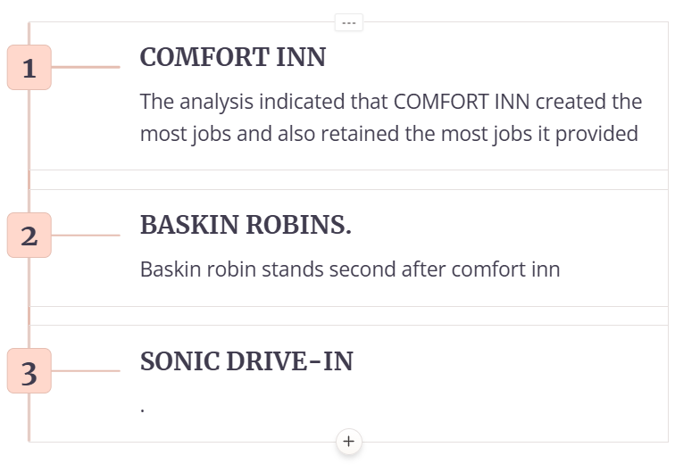

Job creation and retention
26

Slide 28

Insights
Through this capstone project, we gained valuable insights into the loan approval dataset. This analysis provided a comprehensive understanding of the lending landscape, key borrowers, geographical distribution, and bank performance. Future steps include further data exploration, advanced analytical techniques like machine learning, and integration with other data sources for more comprehensive analysis.
27

Slide 29

THANK
YOU
28

